Slide 1
Electrical
and Electronics science
First year
Computer Science and Engineering
Dr. Shakti Singh
ASSISTANT PROFESSOR
ELECTRCIAL AND INSTRUMENATION
ENGINEERING DEPARTMENT
@shakti.singh@thapar.edu

Slide 2
Applications of OpAmp
Voltage follower
Summing and Difference Amplifier
Integrator, Differentiator
Phase Shifter
V to I converter
Scale changer
Logarithmic amplifier
Peak detector
Voltage comparator
Noise Suppressor

Slide 3
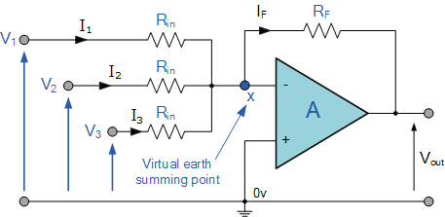
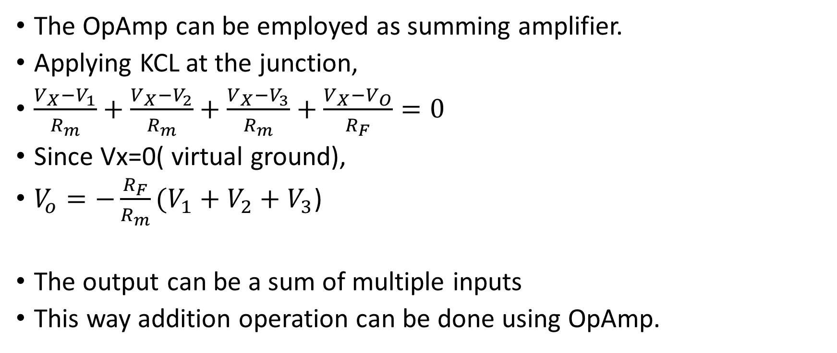
Summing Amplifier
The OpAmp can be employed as summing amplifier.
Applying KCL at the junction,
$\frac{V_{X}−V_{1}}{R_{m}}+\frac{V_{X}−V_{2}}{R_{m}}+\frac{V_{X}−V_{3}}{R_{m}}+\frac{V_{X}−V_{O}}{R_{F}}=0$
Since Vx=0( virtual ground),
$V_{o}=−\frac{R_{F}}{R_{m}}(V_{1}+V_{2}+V_{3}$)
The output can be a sum of multiple inputs
This way addition operation can be done using OpAmp.

Slide 4
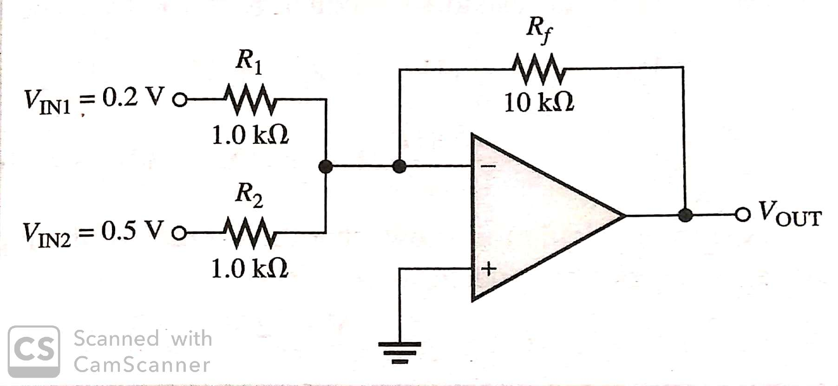
Question
Determine the output voltage of the summing amplifier.

Slide 5

Solution
Applying KCL at the virtual ground terminal,
$\frac{0−V_{IN1}}{R_{1}}+\frac{0−{VIN}_{2}}{R_{2}}+\frac{0−V_{OUT}}{R_{F}}=0$
$\frac{0−0.2}{1k}+\frac{0−0.5}{1k}+\frac{0−V_{OUT}}{10k}=0$
$V_{OUT}=−10 (0.2+0.5$)
$V_{OUT}$=-7V

Slide 6
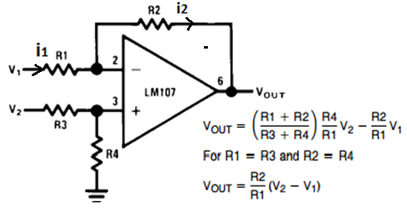
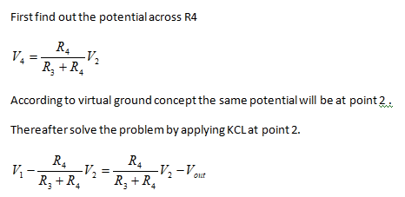
Difference Amplifier
In a difference amplifier we will get output as the difference of the two inputs multiplied by the gain of the Op-Amp.

Slide 7
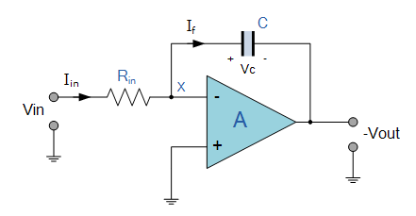




Integrator
An Integrator is a circuit that performs the mathematical operation of Integration, that is we can cause the output to respond to changes in the input voltage over time as the op-amp integrator produces an output voltage which is proportional to the integral of the input voltage.

Slide 8
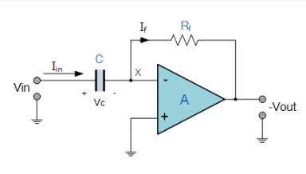

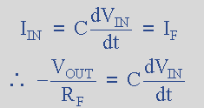

Differentiator
This operational amplifier circuit performs the mathematical operation of Differentiation, that is it “produces a voltage output which is directly proportional to the input voltage’s rate-of-change with respect to time“.

Slide 9

CMRR
The op amp common-mode rejection ratio (CMRR) is the ratio of the common-mode gain to differential-mode gain.

Slide 10
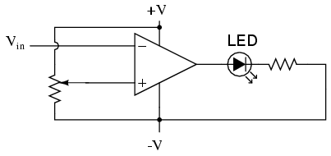

Comparator
V₁
V_{out}
V₂
Uses: Low-voltage alarms, night light controller

Slide 11
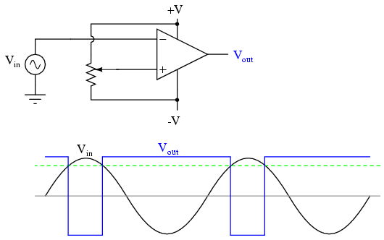
Pulse Width Modulator
Output changes when
V_{in} ~= V_{pot}
Potentiometer used to vary duty cycle
Uses: Motor controllers

Slide 12
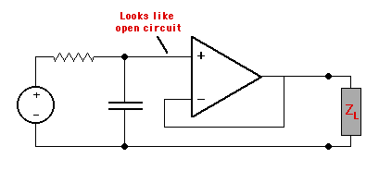
Filters
Decouple the low-pass RC filter from the load. Uses: Simple audio. Remove frequencies over 20kHz (audible)

Slide 13
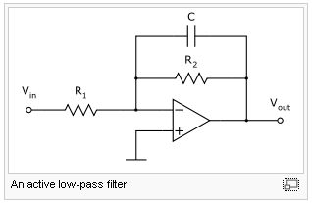

Low-pass Filter (active)
Cutoff frequency
This works because the capacitor needs time to charge.

Slide 14
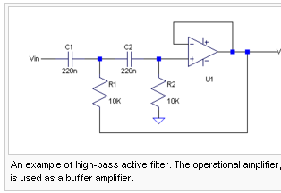
High pass filter (active)
Band-pass filter cascades both high-pass and low-pass!

Slide 15
Practical Application of an op amp Digital to Analog converter

Slide 17
Conclusions
Op-Amps are often used for
Sensor amplification
Mathematical operations (sums, difference, inverse)
Filters (High/Low/Band pass)
Measurement devices

